Slide 1

How to choose a machine learning model
Machine intellegince CSCI417
Under the supervision of
Dr.Ghada Khoriba

Slide 2
Classification models from this course
Logistic regression
Descision tree
KNN
SVM
Naïve byes

Slide 3
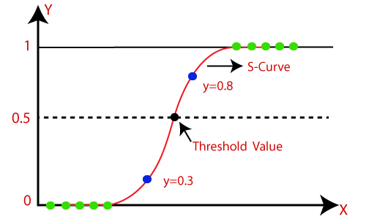
Logistic regression
Use logistic regression if you are trying to do binary classification and want to get the probability that the input data belongs to that class. Logistic regression is a simple and effective classifier for training models. It is a good candidate for predicting a discrete relationship, for example, predicting whether a tumor is malignant or benign given some measured properties.

Slide 4
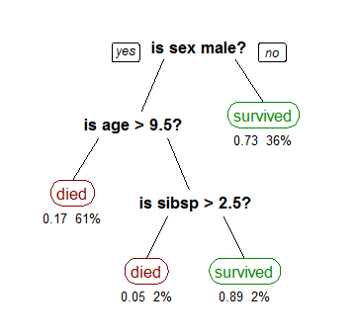
Decision tree
The main benefits of using a decision tree in machine learning is its simplicity, as the decision-making process is easy to visualise and understand. However, decision trees in machine learning can become overly complex by generating very granular branches

Slide 5
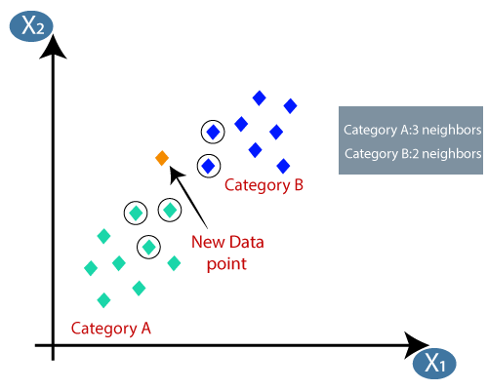
KNN
The KNN algorithm can compete with the most accurate models because it makes highly accurate predictions. Therefore, you can use the KNN algorithm for applications that require high accuracy but that do not require a human-readable model. The quality of the predictions depends on the distance measure.

Slide 6
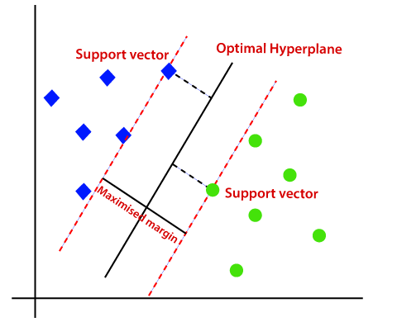
SVM
If you want to do linear classification but the input data is not linearly separable, use Kernelized support vector machines.

Slide 7
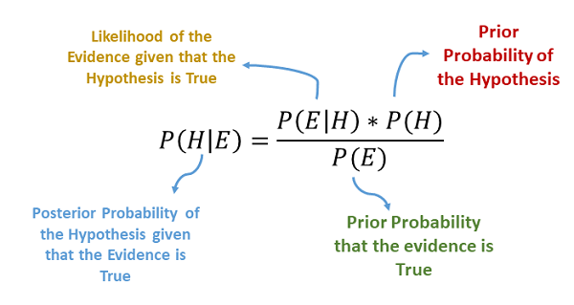
Naïve bayes
A Naive Bayes classifier can be a good choice if you have a relatively small dataset and want to do a fast classification.

Slide 8
Steps for choosing a model
Define problem type
Define your dataset size
Data visualization
Choose more than one suitable model
Compare between different models scores

Slide 9

define the problem type
Continous data --> regression
discerete data --> classification

Slide 10
Define your data set size
recommendations for large datasets
SVM
recommendations for small datasets
Naïve bayes
Decision tree
KNN

Slide 11
Model runtime rank
Naïve bayes and SVM
Logistic regression
Descision tree
KNN

Slide 12
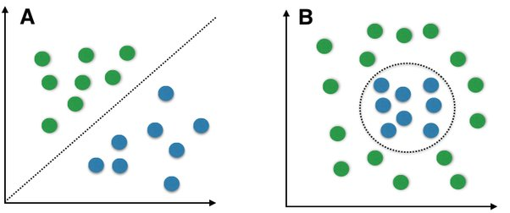
Data visualiztaion
Know the relationship between the features and the target variable and the shape of your data

